Slide 1
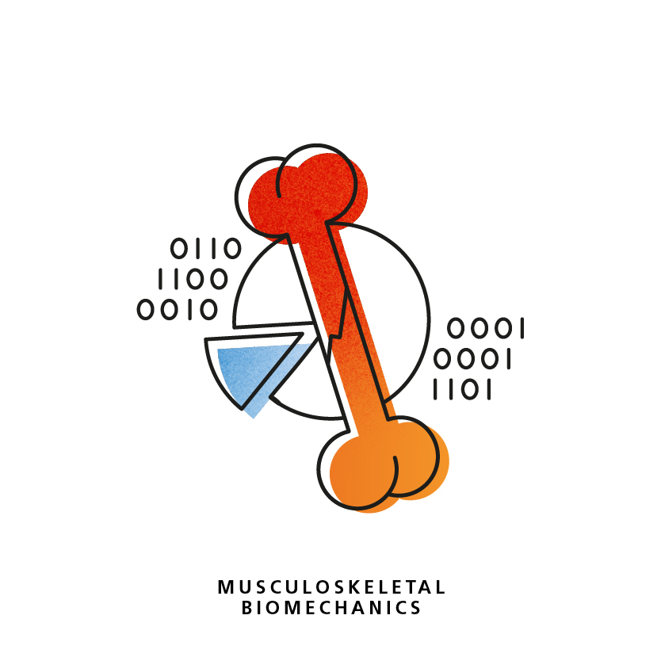

Slide 2
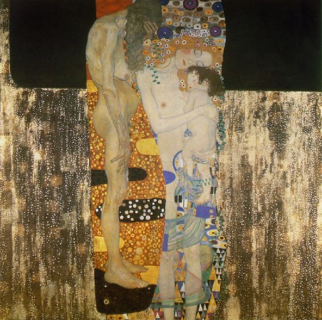
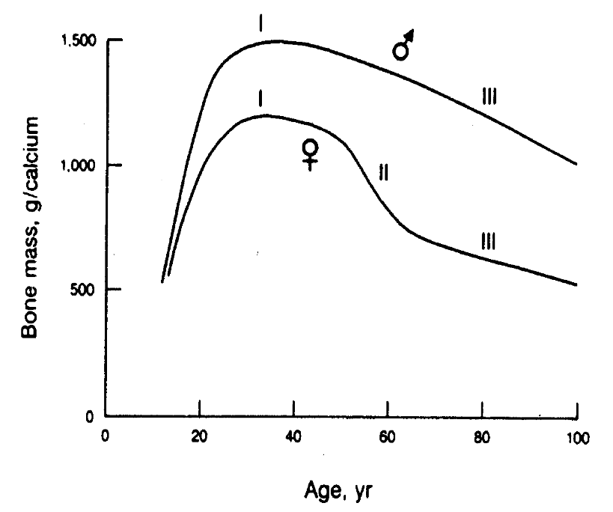
Clinical Problems
Musculoskeletal Biomechanics (ARTORG)
Backpain
Osteoarthritis
Osteoporosis
Sports injury
Notes:
Hip, spine and wrist fractures
1 out of three women and 1 out of 5 men over 50 will undergo a fracture
1 osteoporotic fracture every 3 second in the world
3.5 million fractures in the EU
Fx increase by 28% until 2025

Slide 3
Key Questions
Musculoskeletal Biomechanics (ARTORG)
Basic
• What are the hierarchical mechanical properties of bone?
Engineering
• How can strength of bone and bone-implant systems be estimated?
Clinical
• How can bone fracture and implant failure risk prediction be improved?
Notes:
Basic question: what causes bone fragility?
Technological question: how can bone strength be estimated?
Clinical question: how can we improve diagnosis and monitoring of osteoporosis?

Slide 4
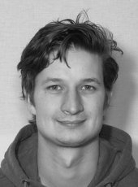
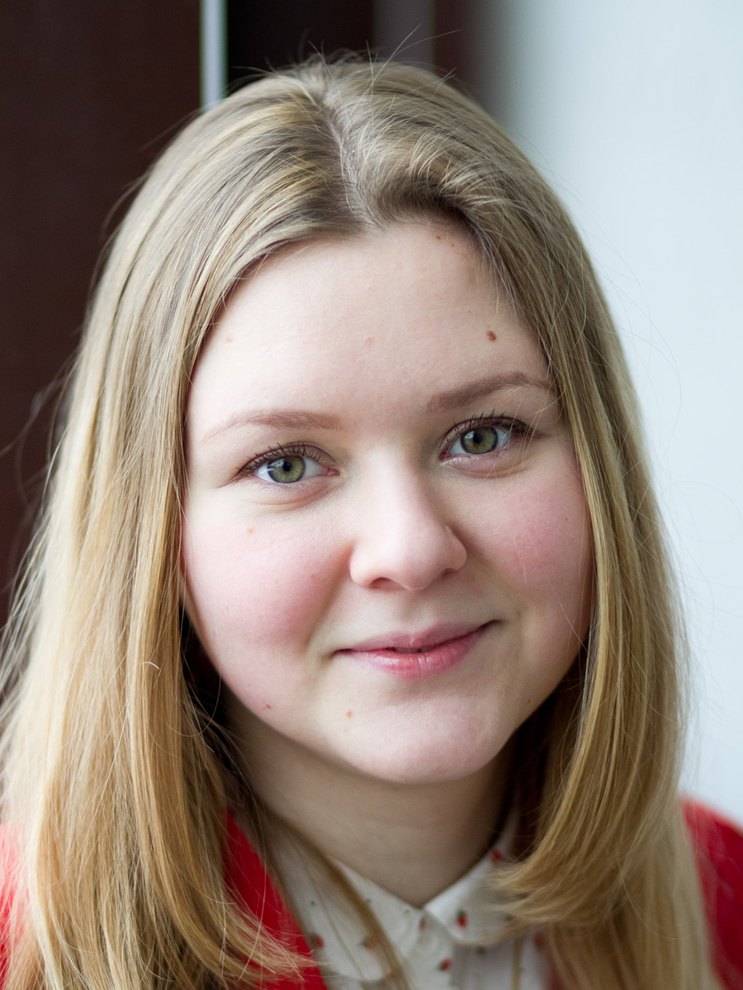



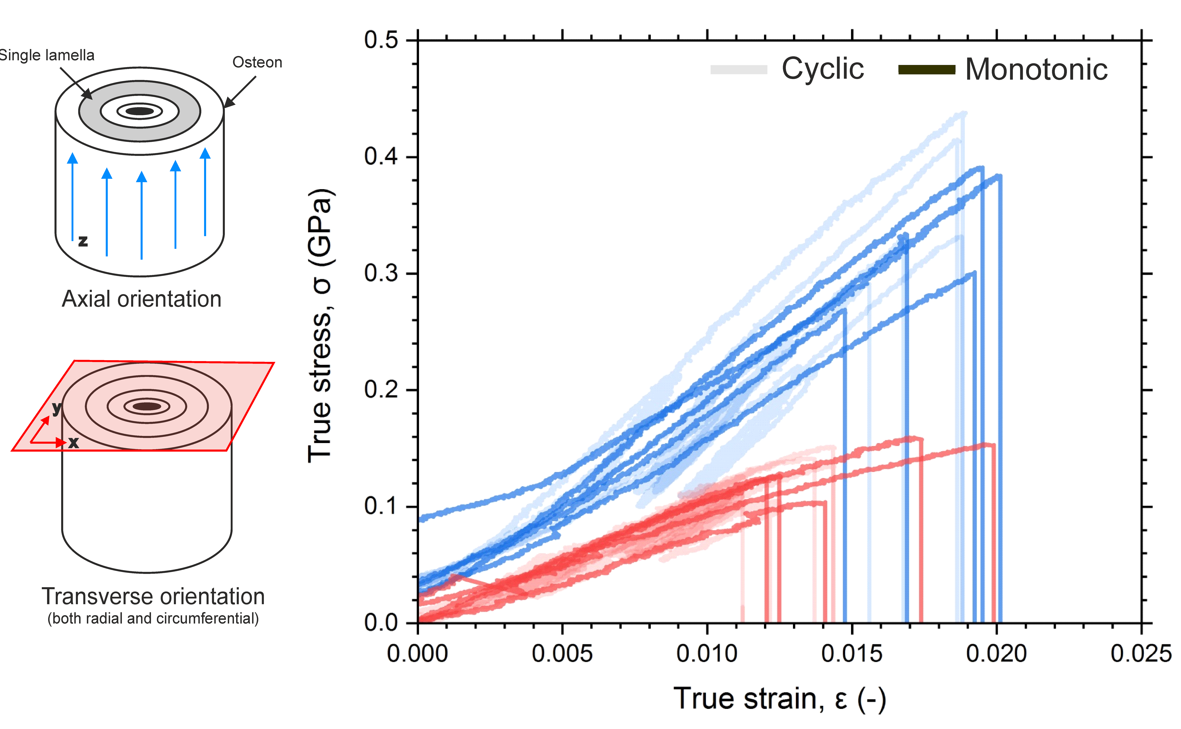
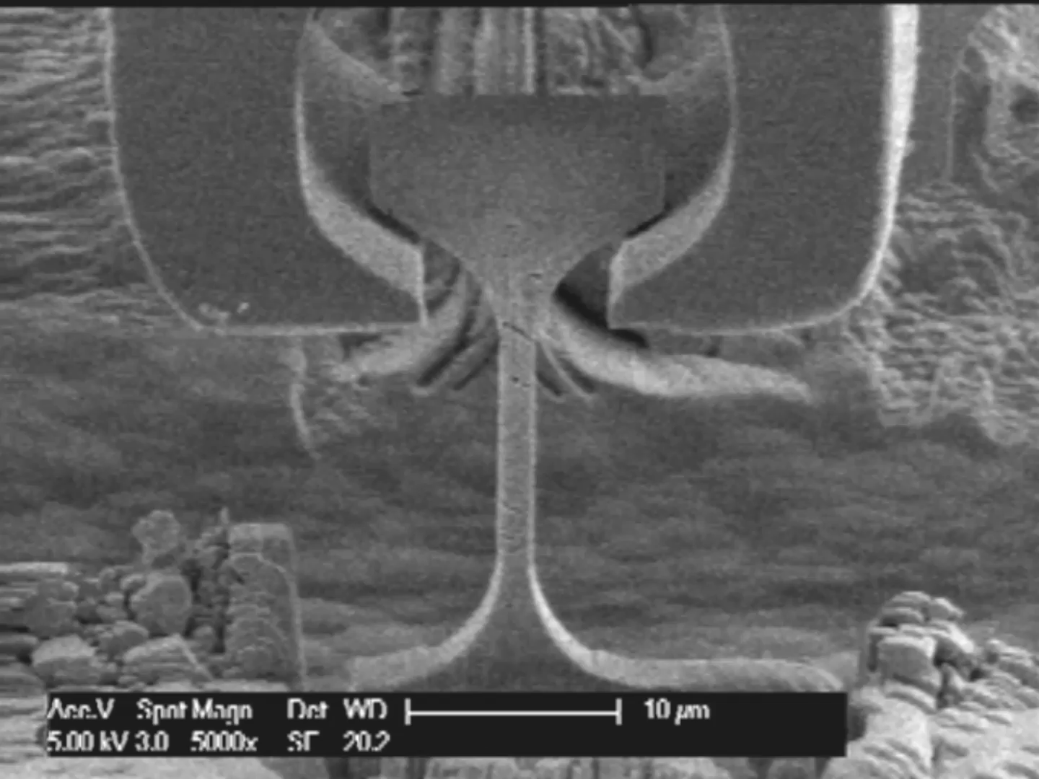
Basic Experimental Research (with EMPA)
Musculoskeletal Biomechanics (ARTORG)
Notes:
SNF project with EMPA and former PhD student Jakob Schwiedrzik

Slide 5
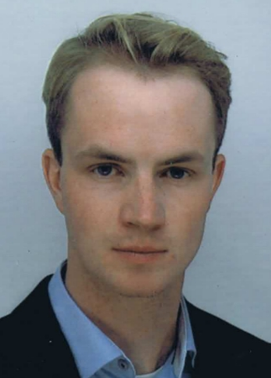
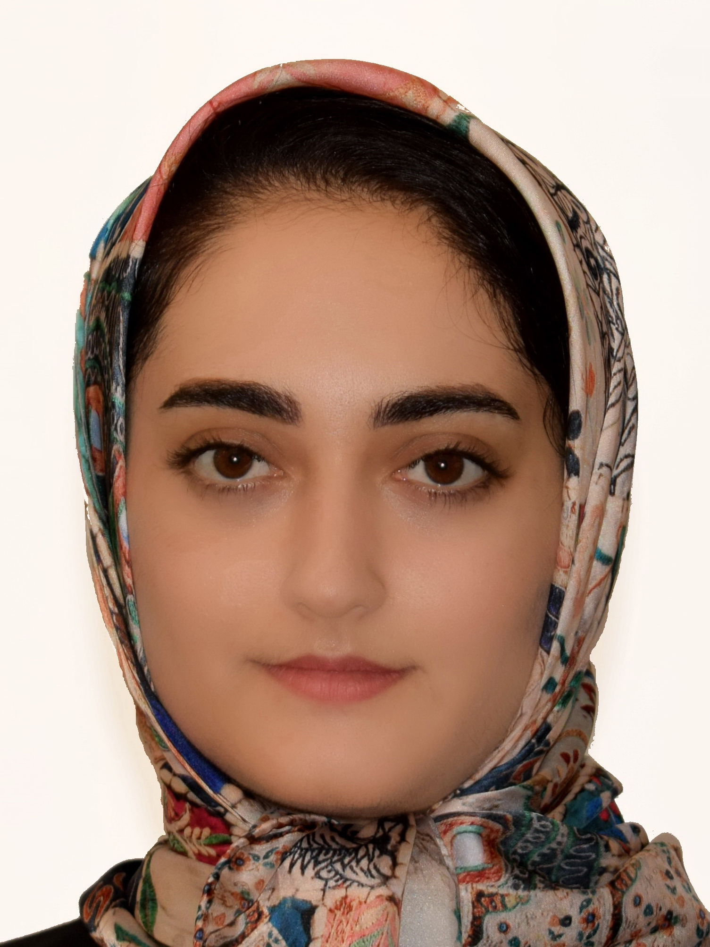
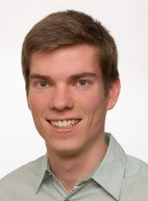
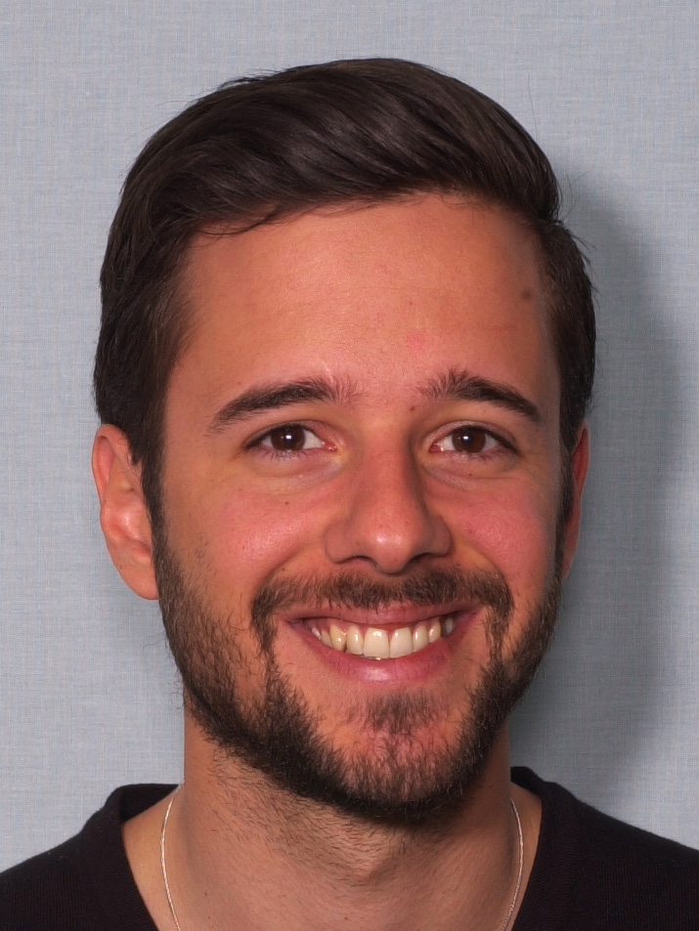
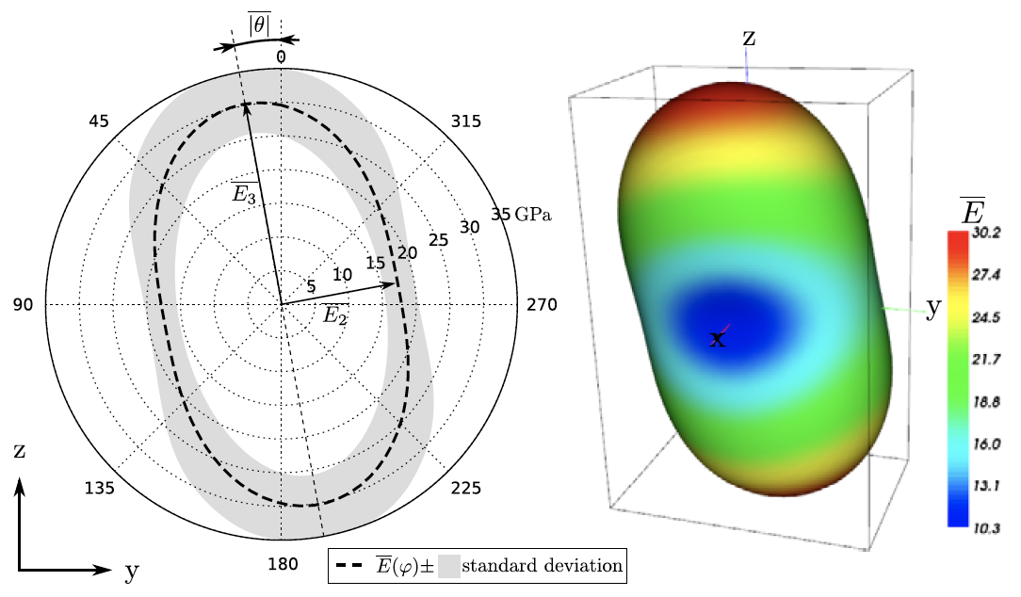
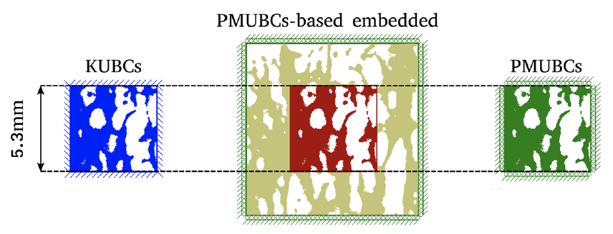
Multiscale Computational Analysis
Musculoskeletal Biomechanics (ARTORG)
Notes:
CT, HR-pQCT I or II,
PhD thesis internally

Slide 6
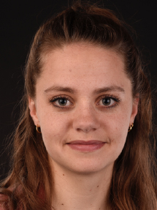
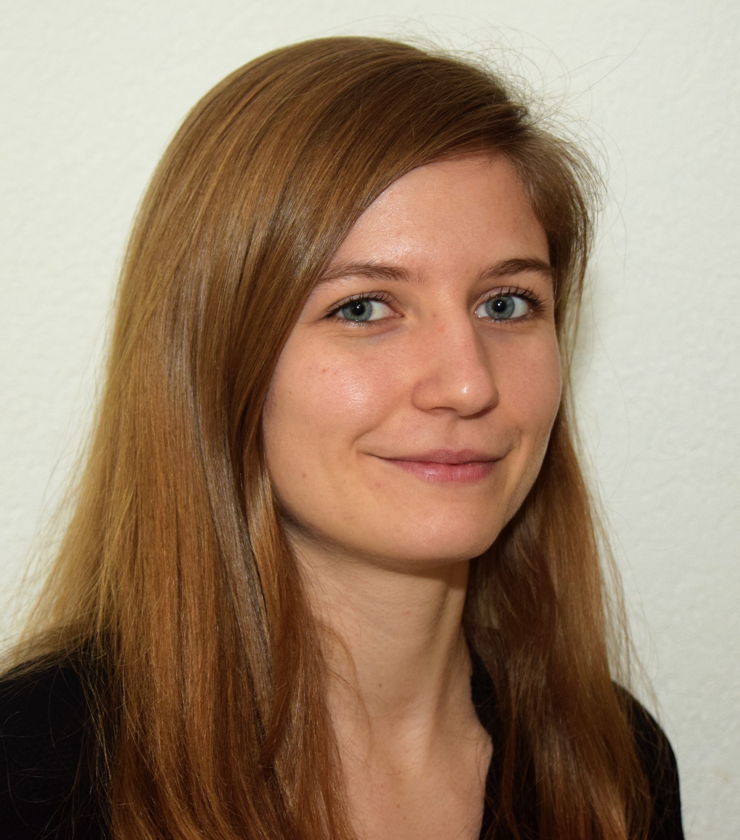
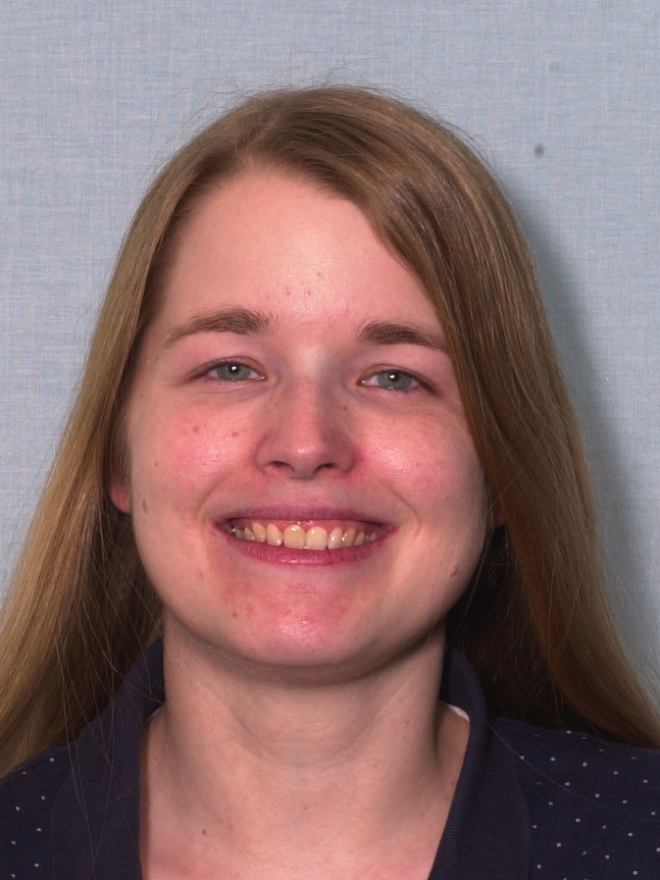
Clinical Studies
Musculoskeletal Biomechanics (ARTORG)
MEREO 2018-2020 with Shriners Children Hospital, Montreal
NODARATIS 2019 with PO Inselspital
BOLD 2019-2020 with PO Inselspital and University Hospital Basel
PARATY 2020 with PO Inselspital
SINERGIA 2019-2023 with University Hospital Geneva

Slide 7
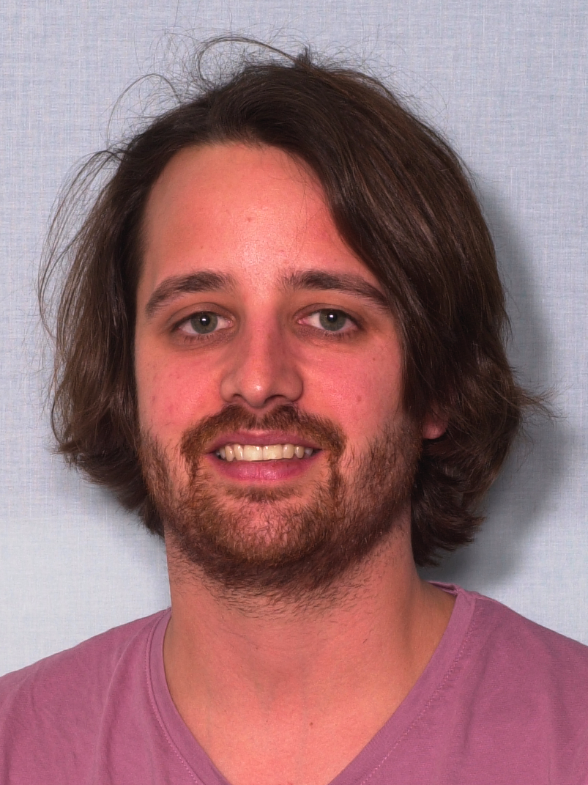
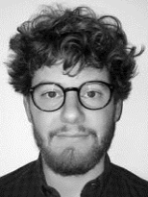
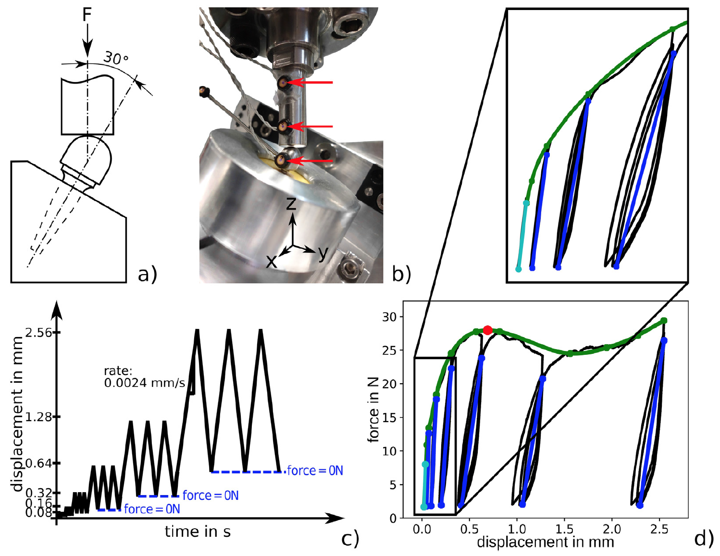
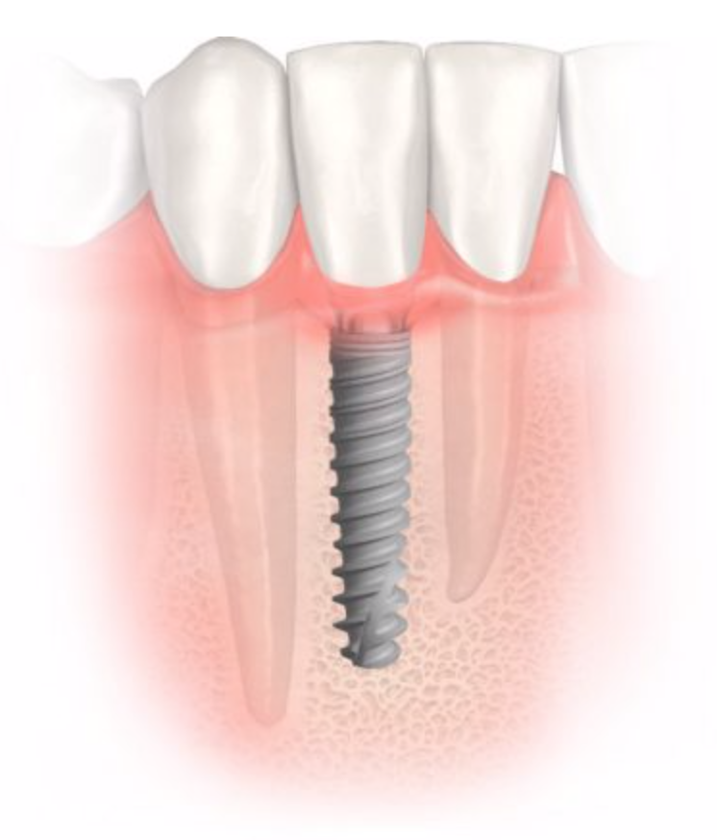
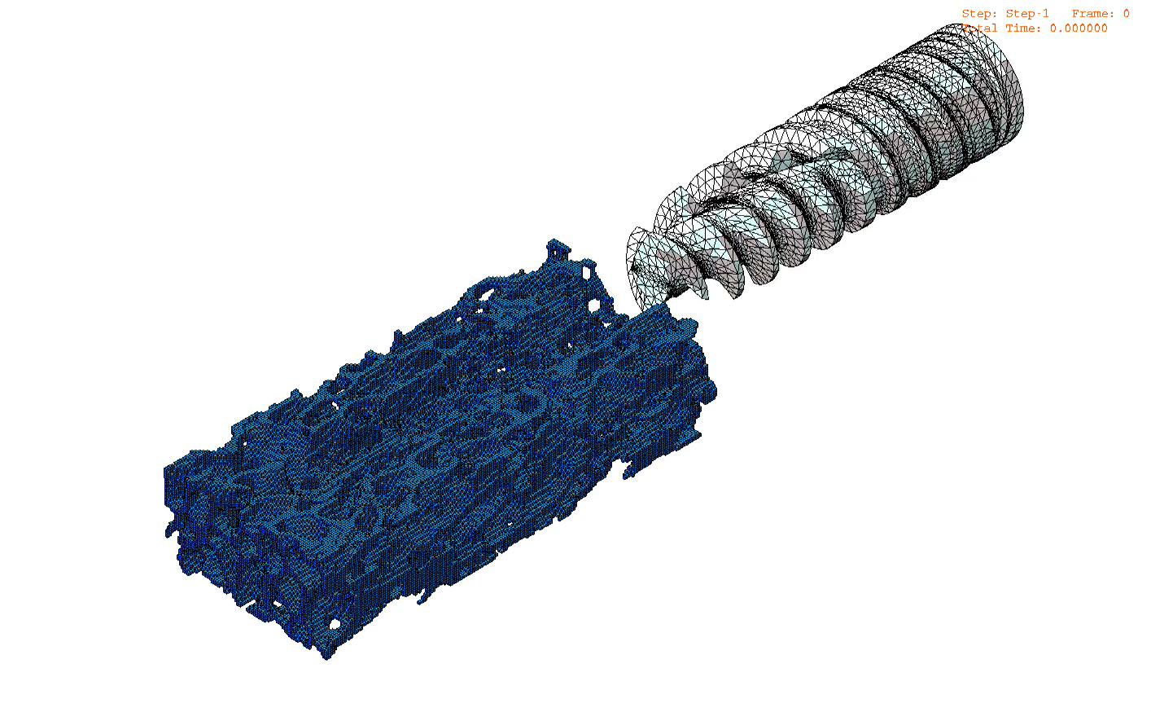
Novel Focus: Bone-Implant Interface
Musculoskeletal Biomechanics (ARTORG)
Notes:
PhD thesis with RMS
Collaboration with Nobel Biocare and Anton Paar
Develop collaboration with ZMK
Exploitation of CBCT?

Slide 8
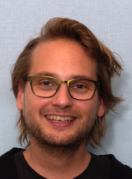
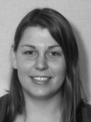
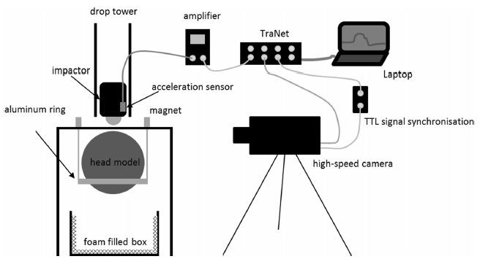
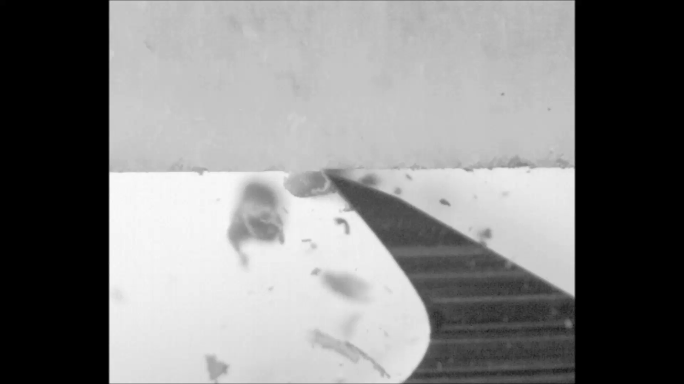
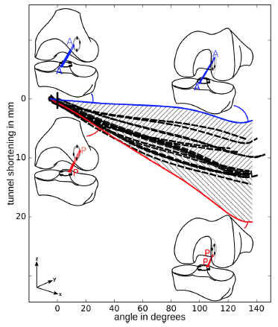
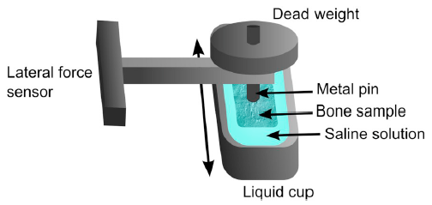
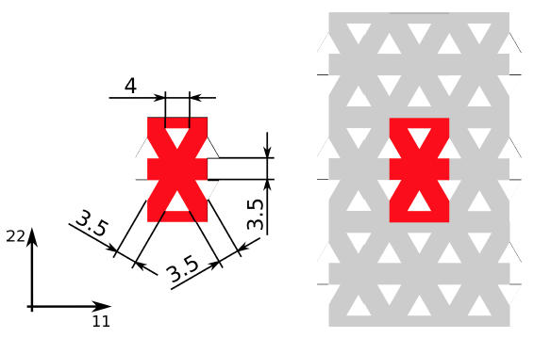
Diverse Musculoskeletal Projects
Musculoskeletal Biomechanics (ARTORG)
Notes:
Orthopaedics

Slide 9




Partners
Musculoskeletal Biomechanics (ARTORG)
University of Bern, Inselspital
University of Geneva, HUG
EMPA
Vienna University of Technology
University of Erlangen
University of Lyon
University of Sheffield
Robert Mathys Stiftung
Nobel Biocare
Anton Paar

Slide 10
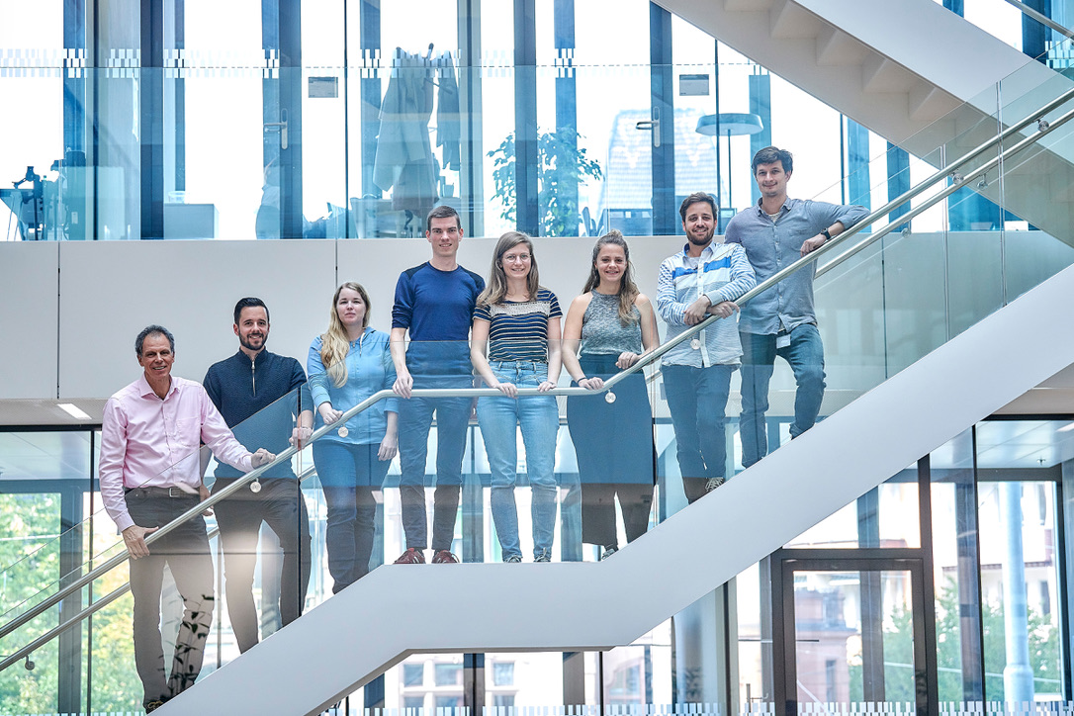
Musculoskeletal Biomechanics (ARTORG)

